Slide 1
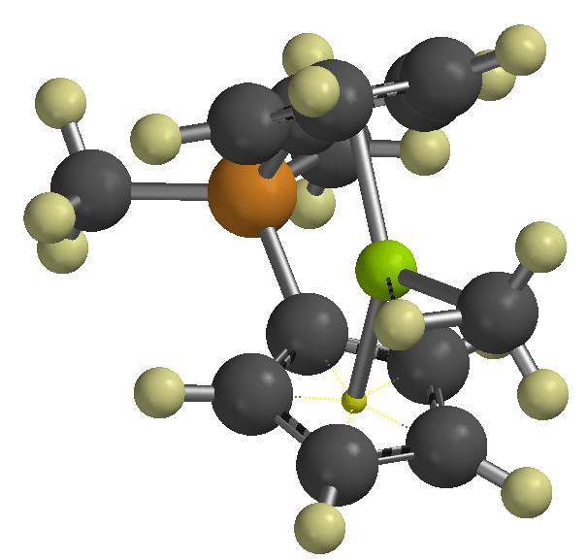
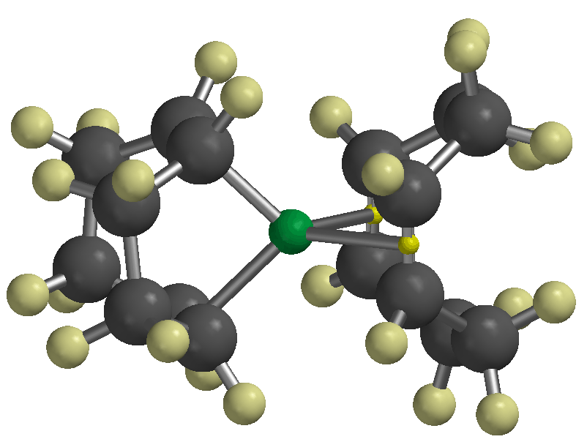
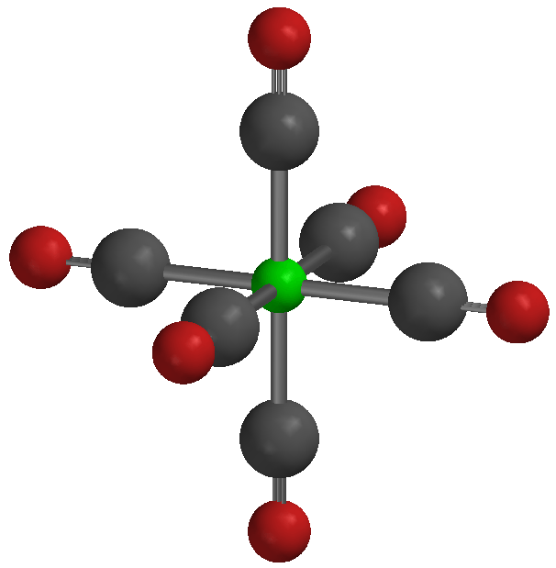
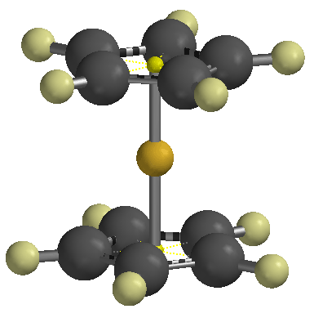
Organometallic Chemistry

Slide 2
organometallics
incorporating carbon-metal bonds
have been known and studied for nearly 200 years
their unique properties have been widely used to effect synthetic transformations.
Depending on the reduction potential of the metal, the reactivity of organometallic compounds varies markedly,
the most reactive requiring low to moderate temperatures and inert conditions (atmosphere and solvents) for preparation and use.
In general, the reactivity parallels the ionic character of the carbon-metal bond, which may be estimated from the proton and carbon chemical shifts of methyl derivatives.
% Ionic Character of H₃C – Metal (CH₃)₂Hg < (CH₃)₂Cd < (CH₃)₂Zn < (CH₃)₂Mg < CH₃Li

Slide 3
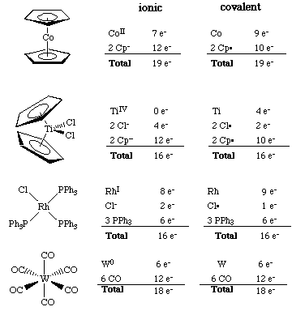
The 18 electron rule – The inorganic chemist’s “octet” rule
Knowing how many valence electrons "belong to" a transition metal complex allows us to make predictions about the mechanisms of reactions and the possible modes of reactivity.
There are two distinct methods that are used to count electrons:
the neutral or covalent method and the effective atomic number or ionic method.

Slide 4
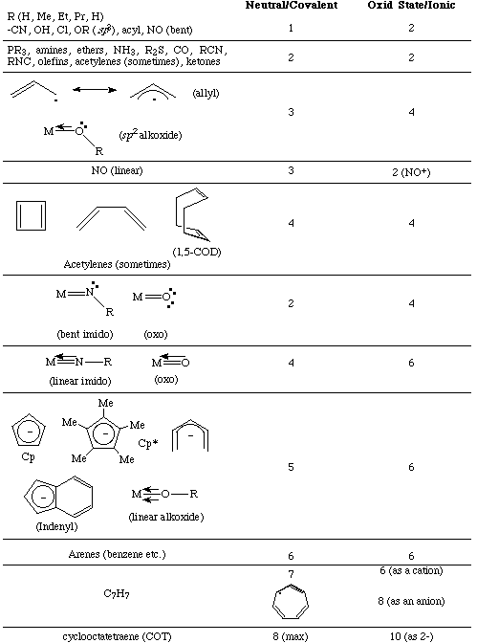
Electron donation of common ligands

Slide 5
organometallics

Slide 6
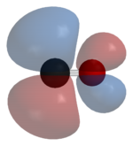
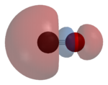
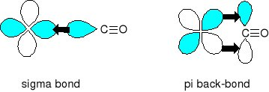
Carbon monoxide
"synergic π* back-bonding"

Slide 7
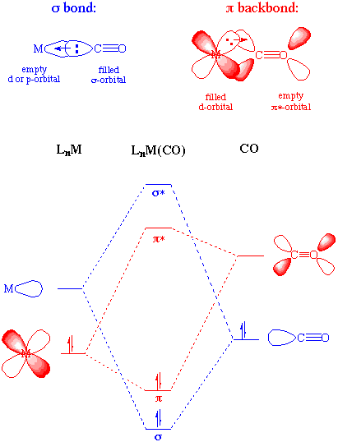
Metal-carbonyl bonding

Slide 8
Metal-carbonyls
Occupation of the π* on CO leads to a decreased bond order in the carbon monoxide molecule itself.
As the π-backdonation becomes stronger, the CO bond order should decrease from that of the free ligand.
Two consequences that we might expect if the CO bond order was reduced would be a lengthening of the C-O bond and a decrease in the carbonyl stretching frequency in the IR. Both of these hold true.
Compound | ν_{CO} (cm⁻¹)
CO | 2143
Ti(CO)₆⁻² | 1748
V(CO)₆⁻¹ | 1859
Cr(CO)₆ | 2000
Mn(CO)₆⁺ | 2100
Fe(CO)₆²⁺ | 2204
Fe(CO)₅ | 2022, 2000

Slide 9
Zeise's salt
Zeise's salt was one of the first organometallic compounds reported.
W. C. Zeise, University of Copenhagen, prepared this compound in the 1820s while investigating the reaction of PtCl₄ with boiling ethanol, and proposed that the resulting compound contained ethylene.
Zeise's proposal was decisively supported in 1868 when Birnbaum prepared the complex using ethylene.
Zeise's salt received a great deal of attention during the second half of the 19th century because chemists could not properly explain the molecular structure of the salt. This question remained unanswered until the advent of x-ray diffraction in the 20th century.

Slide 10
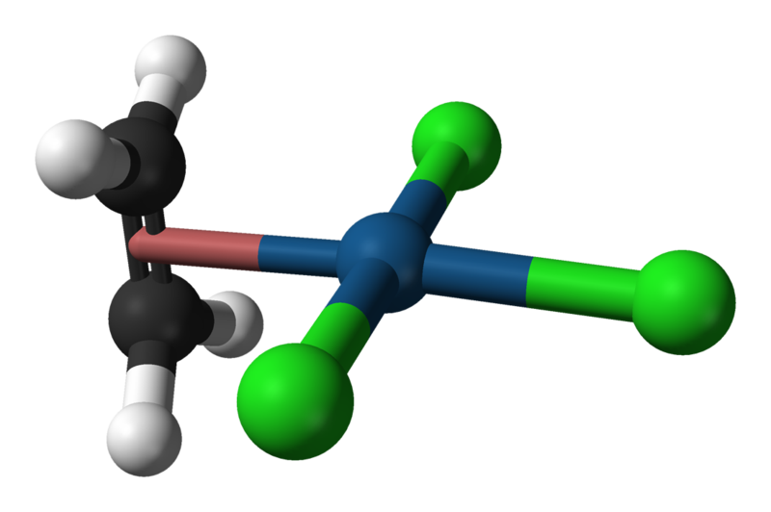
Potassium trichloro(ethene)platinate(II)
η²-ethylene ligand

Slide 11
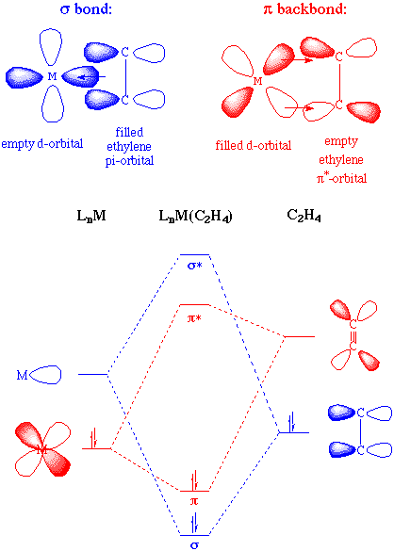
Bonding and Structure in Alkene Complexes
The bonding in alkene complexes is not unlike that seen in carbonyl or phosphine complexes. A σ-type donation from the C=C π orbital with concomitant π-back bonding into an empty π* orbital on the ethylene presents us with a synergistic bonding situation: the greater the σ donation to the metal, the greater the π-back bonding
The greater the electron density back-donated into the π* orbital on the alkene, the greater the reduction in the C=C bond order.

Slide 12
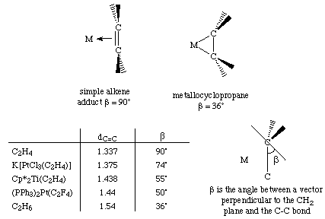
Bonding and Structure in Alkene Complexes
The greater the electron density back-donated into the π* orbital on the alkene, the greater the reduction in the C=C bond order.
a planar olefin adduct and a metallocyclopropane. X-ray crystallographic studies confirm that the as the C-C bond length increases, the CH₂ plane is distorted from the ideal planar geometry of an alkene:

Slide 13
Potassium trichloro(ethene)platinate(II)
η²-ethylene ligand

Slide 14
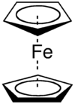
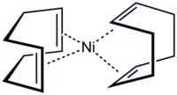
Hapticity
Describes how a group of contiguous atoms of a ligand are coordinated to a central atom. Hapticity of a ligand is indicated by the Greek character 'eta', η.
A superscripted number following the η denotes the number of contiguous atoms of the ligand that are bound to the metal.
Ferrocene contains two
η⁵-cyclopentadienyl ligands
Bis(η⁴-1,5-cyclooctadiene)nickel(0) Ni(cod)₂

Slide 16
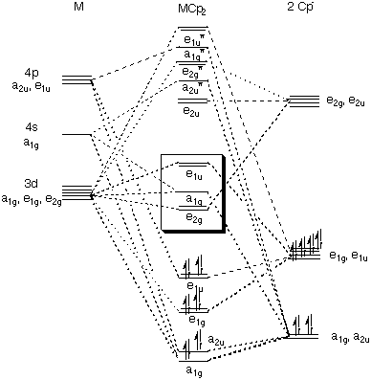
Bonding in Cp Complexes

Slide 18
M-H and M-C σ-bonds

Slide 19
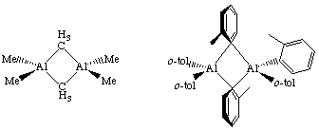
metal alkyls
For simple metal alkyls, the M-R bond distance is typically 190 to 220 pm. This is approximately the sum of the covalent radii of carbon and metal, r_{C} = 77 pm and r_{M} ~120 pm. Realize that the first row transition metals are smaller, so any M-X bond distance will usually be smaller by 10-20 pm or so.
Alkyls can bridge two metal centers, something that is well known from aluminum-alkyl chemistry. For example, consider the condensed phase structure of these Al-alkyls (see Oliver et. al. Organometallics 1982, 1, 1307):

Slide 20
metal alkyls- highly reactive
Water:
Me₃Al explodes with water;
alkyl aluminium and water video

Slide 21
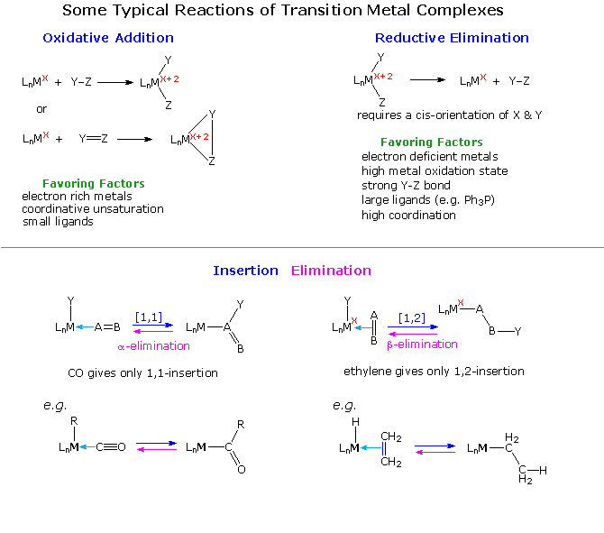
Typical Organometallic Reaction Types

Slide 22
catalysts
The effectiveness of many transition metal compounds as catalysts for reactions comes from the facility of these metals to complex reversibly with a variety of functional groups.
An instructive example of transition metal activation of carbon-carbon double bonds is found in the homogeneous hydrogenation catalyst known as Wilkinson's catalyst.

Slide 23
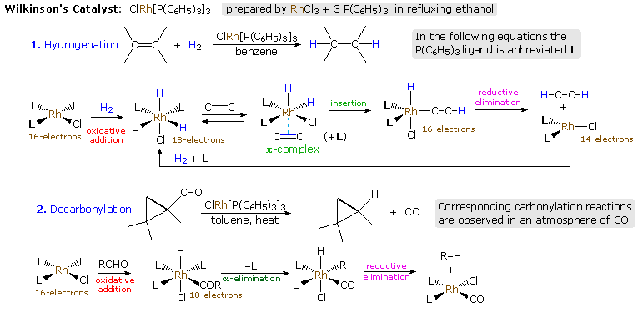
Wilkinson's catalyst, chlorotris(triphenylphosphine)rhodium(I)
Hydrogenation Animation

Slide 24
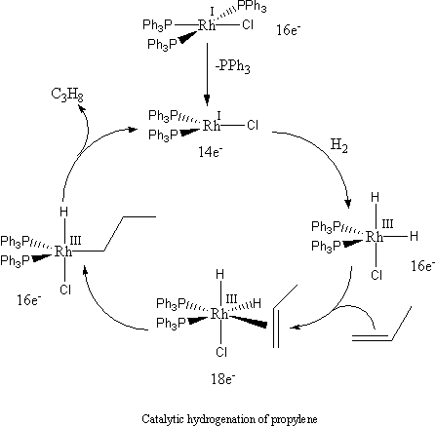
Wilkinson's catalyst, chlorotris(triphenylphosphine)rhodium(I)
Hydrogenation Animation

